Slide 1
Bio& 241 A&P
Unit 4 Lecture 3

Slide 2
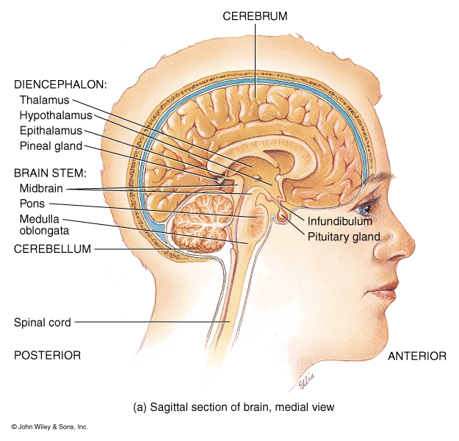
Structural and Functional Areas of the Medulla Oblongata
Cardiovascular Center:
Regulates the rate and force of the heartbeat and the diameter of blood vessels
Medullary Rhythmicity Area:
adjusts the basic rhythm of breathing via inspiratory and expiratory areas.
Other centers for vomiting,
coughing, and sneezing

Slide 3
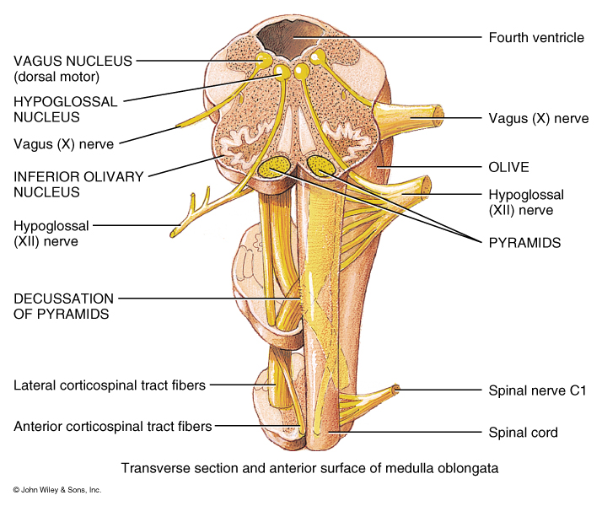
Structural and Functional Areas of the Medulla Oblongata
Pyramids:
Axons from the largest motor tracts from the cerebrum to the Spinal Cord
Decussation of Pyramids:
Crossing of the motor tracts of the pyramids
Nucleus Gracilis: Neuron cells bodies of second order neurons (sensory info)
Nucleus Cuneatus: Neuron cells bodies of second order neurons (sensory info)

Slide 4
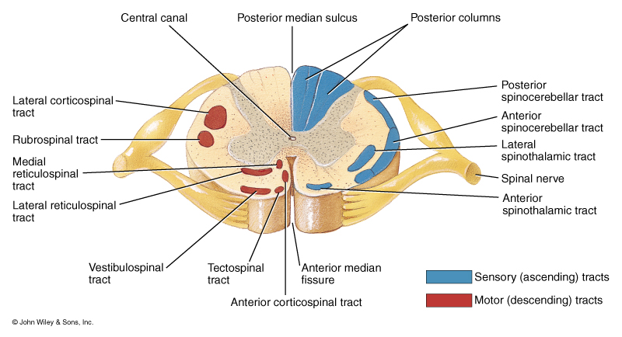
Ascending and Descending Tracts
of the Spinal Cord

Slide 5
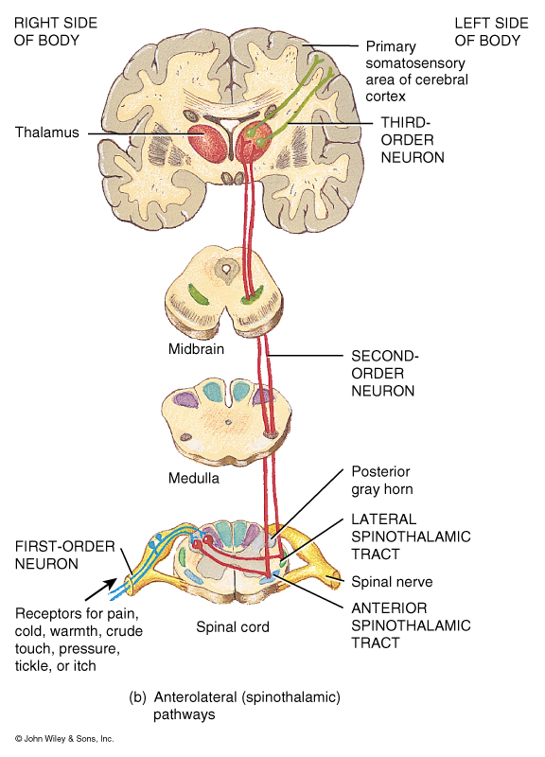
Organization of
Sensory or Ascending
Pathways

Slide 6
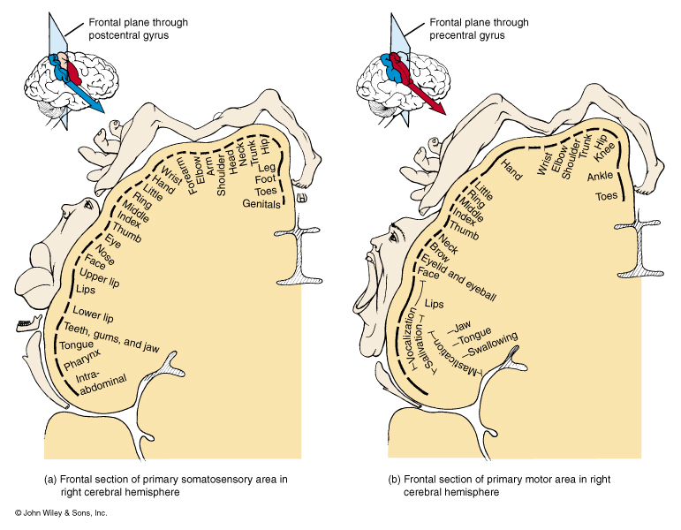

Slide 7
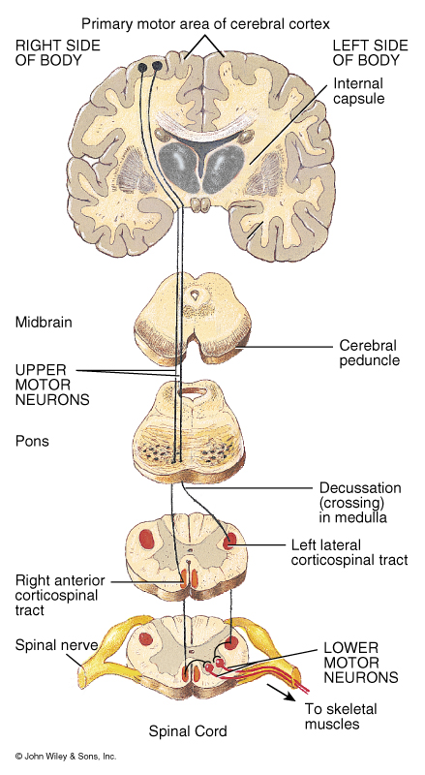
Organization of
Motor or descending
Pathways

Slide 8
Ascending and Descending Tracts
of the Spinal Cord

Slide 10
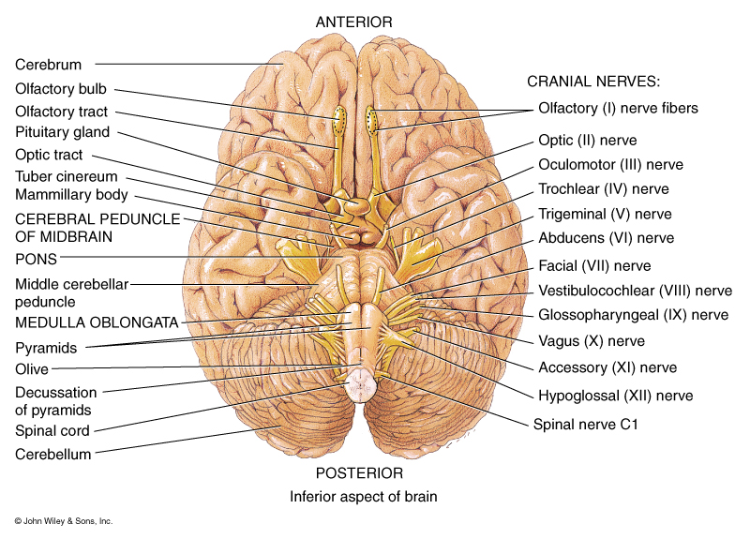
Structural and Functional Areas of the Medulla Oblongata
Contains the Nuclei of five cranial nerves:
Vestibulocochlear
Receive sensory and motor impulses for the cochlea
Glossopharyngeal
Relay sensory and motor impulses related to taste, swallowing, and salivation
Vagus
Sensory and motor impulses for viscera

Slide 11
Structural and Functional Areas of the Medulla Oblongata
Contains the Nuclei of five cranial nerves:
Spinal Accessory
Origin for nerve impulses that control swallowing.
Hypoglossal
Origin for impulses that control tongue movement for speech and swallowing

Slide 12
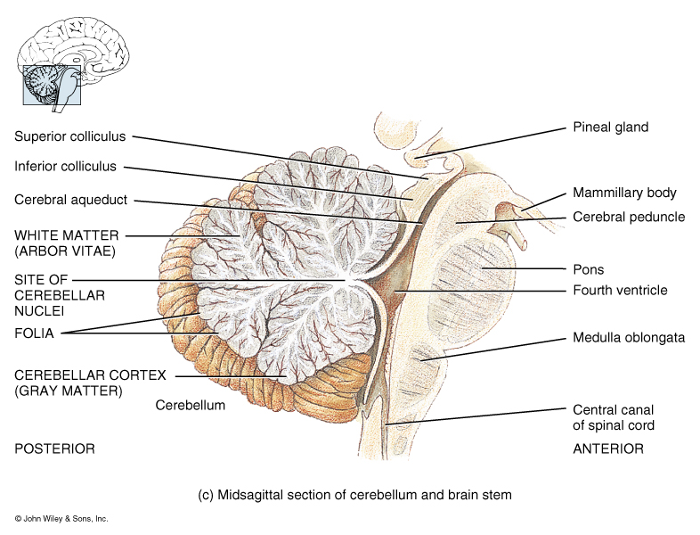
Structural and Functional Areas of the Pons
Bridge that connects medulla and superior brain structures
Longitudinal axons of ascending sensory and descending motor tracts
Transverse axons connect the right and left sides of the cerebellum
Pneumotaxic Area:
transmits inhibitory impulses to the inspiratory area of the medullary rhythmicity area

Slide 13
Structural and Functional Areas of the Pons
Apneustic Area:
Transmits stimulatory impulses to the inspiratory area
Contains the nuclei of four cranial nerves
Trigeminal:
receive somatic sensory impulses from the head and face. Motor impulses the control chewing
Abducens:
Motor impulses to the Lateral Rectus muscle.

Slide 14
Structural and Functional Areas of the Pons
Facial:
Receive sensory impulses for taste and provide motor impulses that regulate saliva, tears, and muscle of facial expression
Vestibulocochlear:
Sensory impulses related to balance and equilibrium

Slide 15
Structural and Functional Areas of the midbrain or Mesencephalon
Cerebral Peduncles:
Tracts that contain axons from the corticospinal and corticobulbar motor neurons
Sensory tracts from the pons and medulla that extend to the thalamus
Corpora Quadrigemina:
Superior colliculi: reflex center for movement of the eyes and head in response to visual stimuli.
Inferior colliculi: reflex center for movement of the head and trunk in response to auditory stimuli.

Slide 16
Structural and Functional Areas of the midbrain or Mesencephalon
Sustantia nigra:
Nuclei that control subconscious muscle activities through the production of dopamine
Red Nuclei: relay area for motor tracts that control coordinated muscular movements
Headquarters of the Reticular formation, the reticular activating system (RAS). Network of interconnected nuclei throughout the brain that produces heightened alertness and excitement or generalized lethargy and sleep

Slide 17
Structural and Functional Areas of the midbrain or Mesencephalon
Nuclei associated with two cranial nerves:
1. Oculomotor: controls movement of the eyeballs, constriction of the pupil, and shape of the lens
2. Trochlear: controls movement of the eyeballs, specifically the Superior Oblique muscle.

Slide 18
Structural and Functional areas of the Cerebellum
1. Second-largest part of the brain
2. Communicates with the motor areas of cerebrum to help provide smooth and coordinated skeletal muscle contractions and movements
3. Folia: folds between leaf-like gray matter of the cerebellar cortex
4. Arbor Vitae: white matter tracts
Connections:
5. Inferior Cerebellar Peduncles
Medulla to cerebellum
6. Middle Cerebellar Peduncles
Pons to cerebellum
7. Superior Cerebellar Peduncles
Midbrain to cerebellum

Slide 19
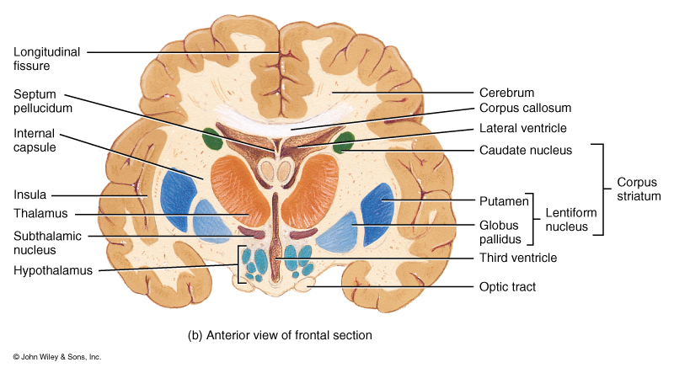
Structural and Functional Areas of the Diencephalon
Thalamus:
Masses of gray matter organized into nuclei with interspersed tracts of white matter.
Functions as a principal relay station for sensory impulses and cognition
Intermediate Mass:
Bridge of gray matter connecting right and left sides

Slide 20
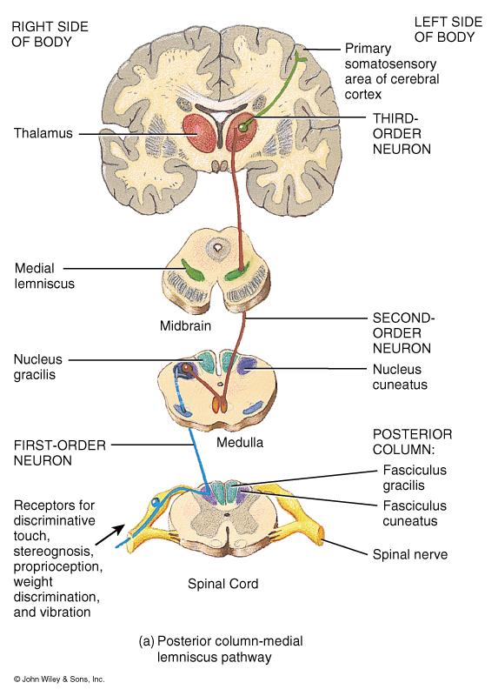
Structural and Functional Areas of the Diencephalon
Thalamus:
Masses of gray matter organized into nuclei with interspersed tracts of white matter.
Functions as a principal relay station for sensory impulses and cognition
Intermediate Mass:
Bridge of gray matter connecting right and left sides

Slide 21
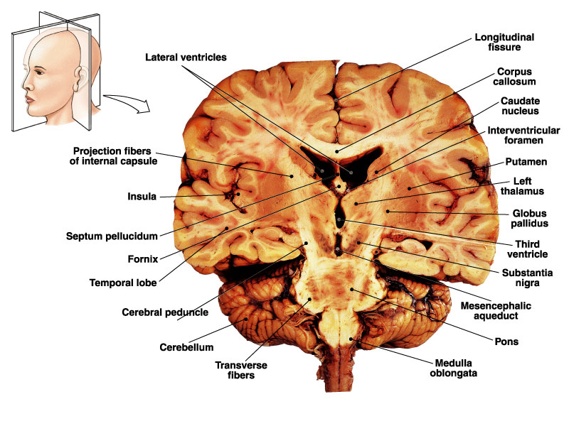
Structural and Functional Areas of the Diencephalon
Nuclei of the Thalamus:
Medial Geniculate Nucleus:
Relays auditory impulses
Lateral Geniculate Nucleus
Relays visual impulses
Ventral Geniculate Nucleus
Relays impulses of taste, somatic touch, somatic pressure, somatic temperature, somatic pain

Slide 22
Structural and Functional Areas of the Diencephalon
Hypothalamus:
Controls many body activities and is one of the major regulators of homeostasis.
Mammillary Bodies:
relay center for reflexes related to smell
Infundibulum:
Connect the hypothalamus to the pituitary gland.

Slide 23
Structural and Functional Areas of the Diencephalon
Hypothalamus major functions:
Controls and integrates activities of the Autonomic Nervous System
Produces hormones that control the activity of the pituitary gland
Produces hormones that control urine production, labor contractions, and milk let-down
Regulation of emotional and behavioral patterns related to rage, aggression, pain, pleasure, and behavioral patterns related to sexual arousal

Slide 24
Structural and Functional Areas of the Diencephalon
Hypothalamus major functions:
Regulation of eating and drinking
Feeding center (hunger)
Satiety center (inhibits feeding center)
Thirst Center
6. Control of body temperature
7. Regulation of Circadian rhythms and states of consciousness

Slide 25
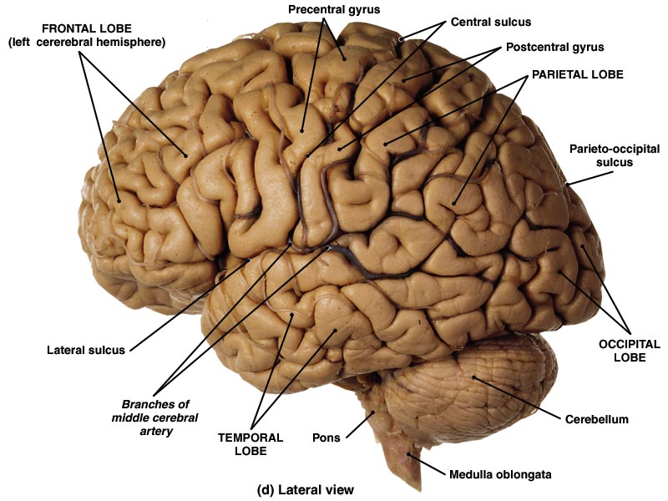
Structural and Functional Areas of the of the cerebral hemispheres
Cerebral cortex: Integration and processing of sensory input and initiation of motor activities
a. Frontal: voluntary control of skeletal muscles
b. Parietal: Sensory perception
c. Occipital: visual stimuli
d. Temporal: auditory and olfactory stimuli

Slide 26
Structural and Functional Areas of the of the cerebral hemispheres
  2. Cerebral Nuclei:
Subconscious control of skeletal muscle tone and the coordination of learned movement patterns

Slide 27
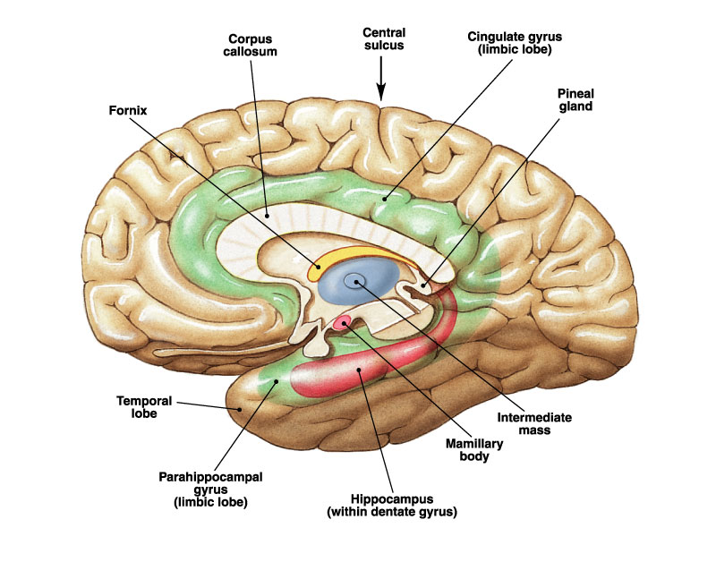
Structural and Functional Areas of the of the cerebral hemispheres
3. Limbic System:
a. establishing emotional states
b. linking conscious intellectual functions with the unconscious autonomic functions
c. Facilitating memory storage and retrieval

Slide 28
Memory and Synaptic Plasticity
Memory trace: a pathway of neurons that form synapses.
Synaptic Plasticity: Thought learning and experience we have the ability to form new synapses, to remove, or modify existing synapses to make transmission easier.
Facilitation: Rapid arrival of repeated signals at the synapse that make it easier for the postsynaptic neuron to create a EPSP. Involves the build up of Ca2+ through tetanic stimulation.
Posttetonic Potentiation: Facilitates memories that last for a few hours. Involved long term build up of Ca2+ in the presynaptic the allows increased release of neurotransmitters and the excitement of the postsynaptic neuron.

Slide 29
Memory and Synaptic Plasticity
Immediate Memory: The ability to hold something in memory for just a few seconds. Very important to reading.
Short-Term Memory (STM): Last for a few seconds to a few hours. Quickly forgotten if it’s not reinforced.
Working Memory: a form of STM we use frequently such as in looking up a phone number and remembering it long enough to dial the phone

Slide 30
Memory and Synaptic Plasticity
Long-Term Memory (LTM) Last a lifetime and is less limited. Involves the remodeling of synapses or the formation of new synapses through the growth and branching of axon terminals and/or dendrites. Believed to involve pyramidal cells.
Declarative Memory: Retention of events and facts that you can put into words, numbers, names, and dates
Procedural Memory: Retention of motor skills; how to tie your shoes, play a musical instrument, or type on a keyboard.

Slide 31
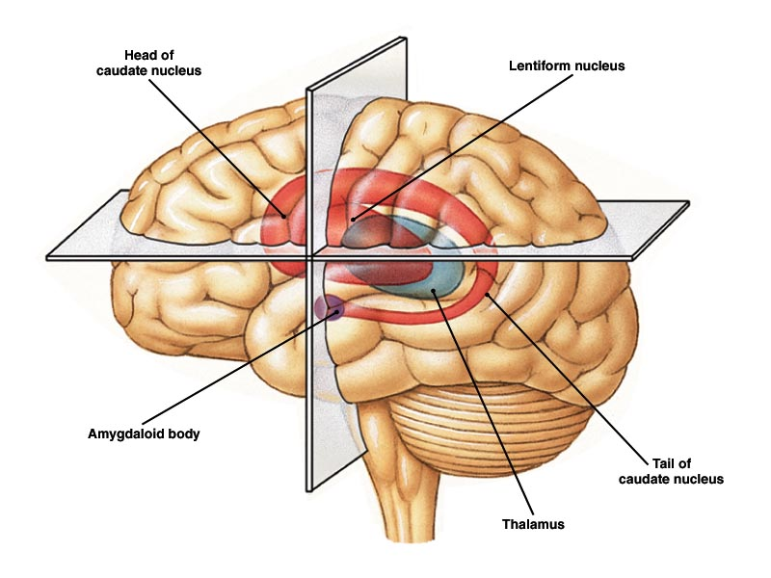
Organization of the Basal Nuclei or ganglia

Slide 32
Primary Function of the Basal Ganglia
Basal ganglia (nuclei) are involved with the subconscious control of skeletal muscle tone and the coordination of learned patterns
These nuclei do not initiate movement.
As you begin a voluntary movement the basal nuclei control and adjust muscle tune of the appendicular muscles

